Slide 1
Data Structures and Algorithms Week-1 Arrays
Bostan Khan
bostankhan6@gmail.com

Slide 2
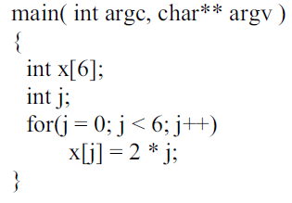
Arrays
Consider the following program:

Slide 3
Arrays
What is x? x is a name of collection of items. Its individual items are numbered from zero to one less than array size.
To access a cell, use the array name and an index as under:
x[0], x[1], x[2], x[3], x[4], x[5]

Slide 4
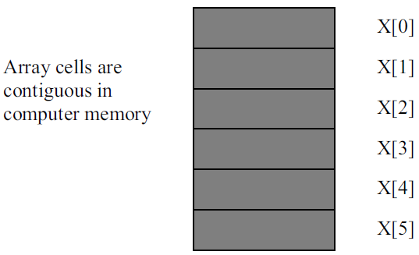
Arrays
Array cells are contiguous in computer memory

Slide 5
Arrays
Array occupies contiguous memory area in the computer.
In case of the above example, if some location is assigned to x[0], the next location can not contain data other than x[1].
The computer memory can be thought of as an array. It is a very big array.

Slide 6
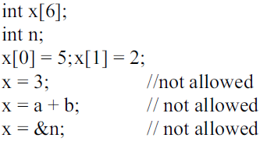
Arrays
We have declared an array named x. ‘x’ is an array’s name but there is no variable x. ‘x’ is not an lvalue. If some variable can be written on the lefthand side of an assignment statement, then that is an lvalue variable.
If we have the code int a, b; it can be written as b = 2;
‘x’ is a name of array and not an lvalue. So it cannot be used on the left hand side in an assignment statement.

Slide 7
Arrays
Consider x as a constant. Its name or memory location can not be changed. This is a collective name for six locations. We can access these locations as x[0], x[1] up to x[5]. This is the way arrays are manipulated.

Slide 8
Arrays: Dynamic Allocation of Memory
Suppose you need an integer array of size n after the execution of the program.
The programming statement is as follows:
int* y = new int[20];
It means we are requesting computer to find twenty memory locations. On finding it, the computer will give the address of first location to the programmer which will be stored in y.
However, here y is an lvalue.
Being a pointer, it is a variable where we can store the address of some variable.
As y is a pointer variable so it can be used on the left-hand side.
y = &x[0]; Or y = x;
But be careful, by doing so the address to the original array pointed to by y would be lost resulting in memory leakage.
And you cannot use delete[] y; to release memory of x either because it is a statically allocated array.

Slide 9
Arrays: Dynamic Allocation of Memory
Suppose you need an integer array of size n after the execution of the program.
The programming statement is as follows:
int* y = new int[20];
Once you have no use for the new array defined above you can release the memory pointed to by the y variable by the following code:
delete[] y;
After using delete[] y, the memory that y was pointing to is deallocated, but the pointer y itself still exists. However, the content of the pointer becomes indeterminate, meaning it points to a memory location that is no longer valid (since it has been deallocated).
Additionally, if you want to copy the contents of array x to the dynamically allocated array y, you should use std::copy or a loop to copy the elements individually

Slide 10
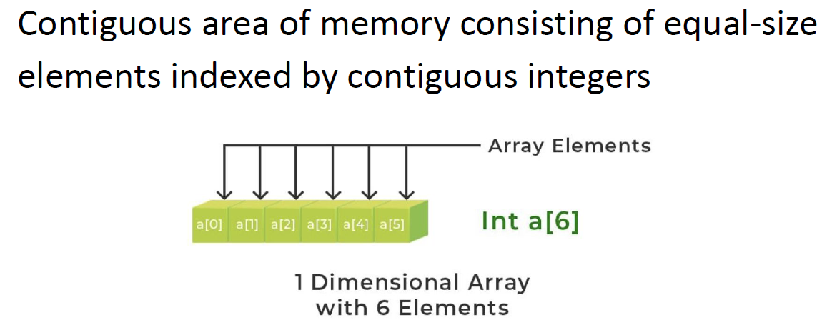
Arrays

Slide 11
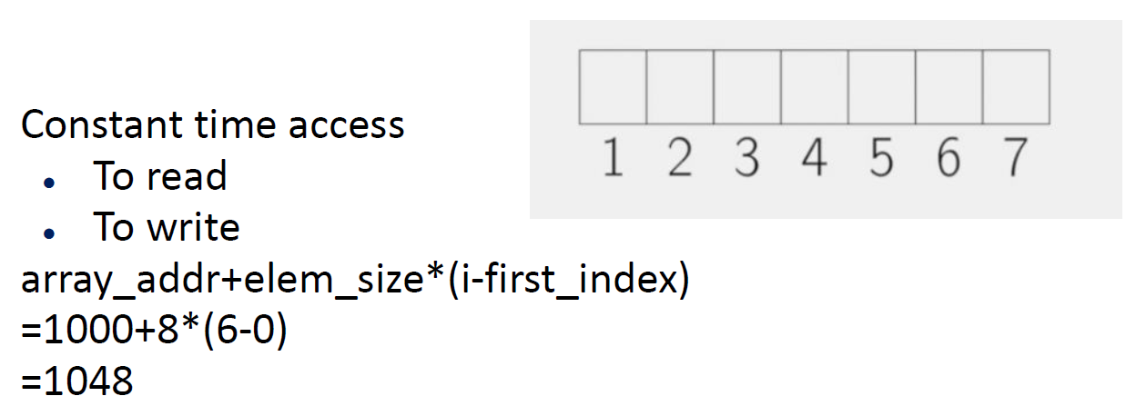
Arrays

Slide 12
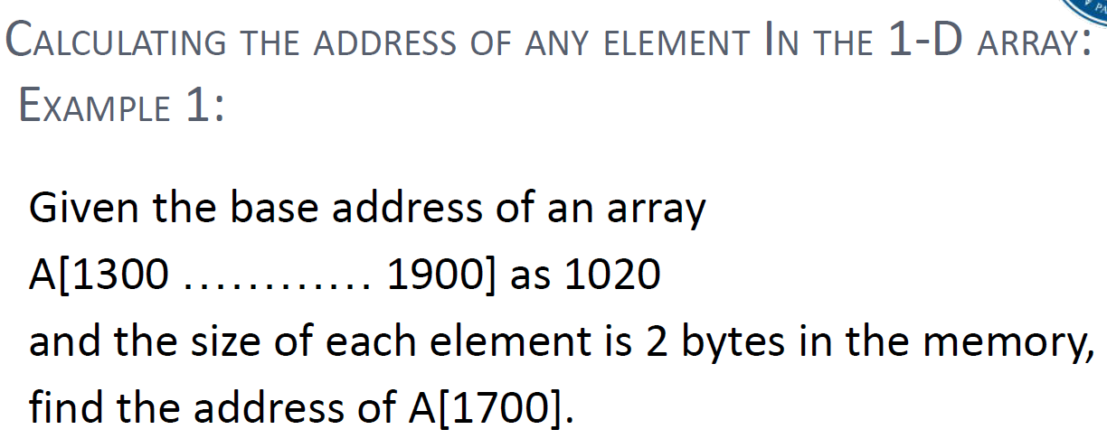
Arrays: Example 1

Slide 13
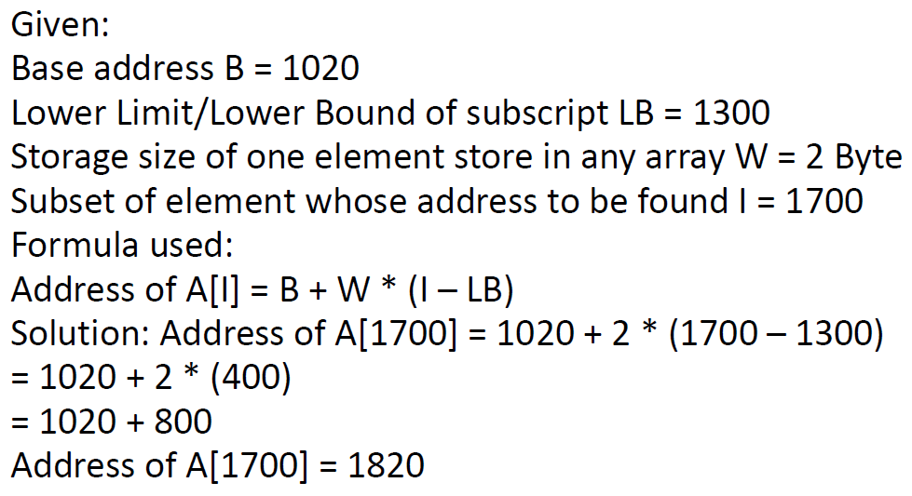
Arrays: Example 1 Solution

Slide 14
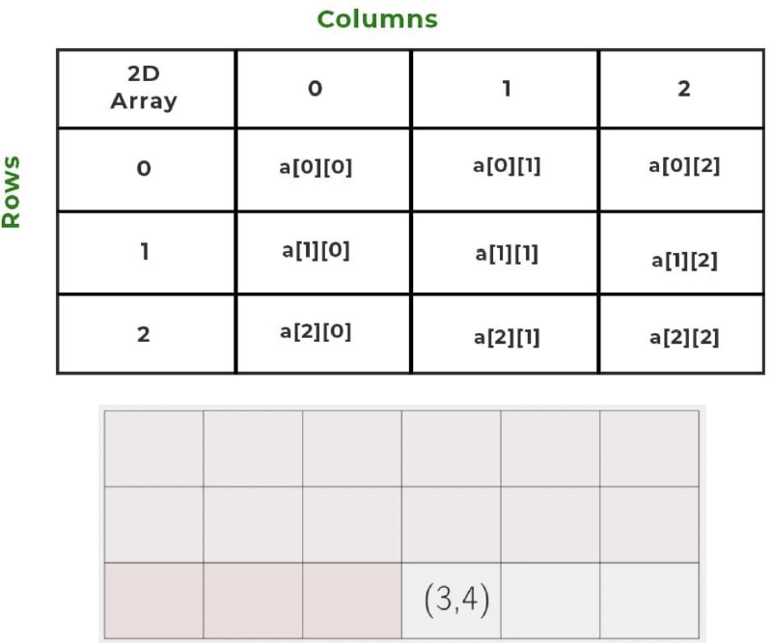
Multi-Dimensional Array (Array of an array) 2D Arrays

Slide 15
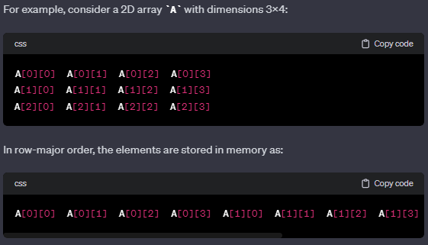
2D Array Row-Major Order:
In row-major order, elements of each row are stored consecutively in memory. This means that for a 2D array, the elements of the first row are stored first, followed by the elements of the second row, and so on. In a row-major layout, the memory address increases primarily along the rows.

Slide 16
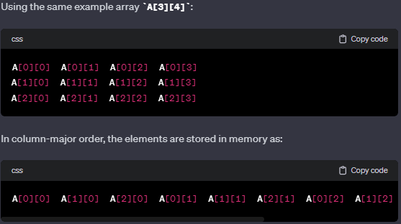
2D Arrays Column-Major Order:
In column-major order, elements of each column are stored consecutively in memory. This means that for a 2D array, the elements of the first column are stored first, followed by the elements of the second column, and so on. In a column-major layout, the memory address increases primarily along the columns.

Slide 17
2D Arrays
How to calculate the memory address of an element in a two-dimensional array based on its indices, taking into account whether the array is stored in row-major order or column-major order.

Slide 18
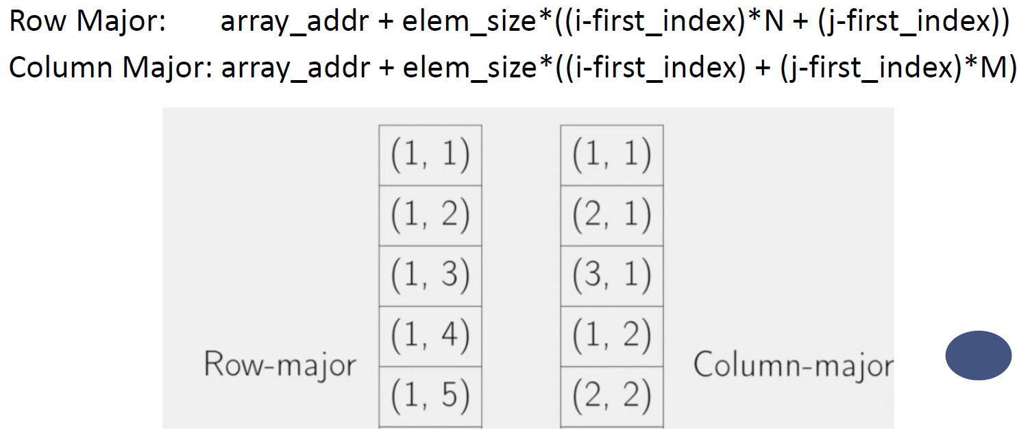
2D Arrays
Read notes of this slide for more details!
Notes:
The expressions provided describe how to calculate the memory address of an element in a two-dimensional array based on its indices, taking into account whether the array is stored in row-major order or column-major order.
In these expressions:
array_addr is the address of the starting element of the array.
elem_size is the size of each array element in bytes.
i and j are the row and column indices of the desired element.
first_index is the index of the first element in the array (usually 0 for most programming languages).
N is the number of columns in the array.
M is the number of rows in the array.
Row Major Order:
In row-major order, elements of each row are stored consecutively in memory. The expression for calculating the memory address is:
Row Major: array_addr+elem_size×((�−first_index)×�+(�−first_index))Row Major: array_addr+elem_size×((i−first_index)×N+(j−first_index))
Column Major Order:
In column-major order, elements of each column are stored consecutively in memory. The expression for calculating the memory address is:
Column Major: array_addr+elem_size×((�−first_index)+(�−first_index)×�)Column Major: array_addr+elem_size×((i−first_index)+(j−first_index)×M)
These formulas take into account the order in which elements are stored in memory, allowing you to compute the address of a specific element based on its row and column indices. The addition and multiplication operations adjust the memory offset based on the array's layout in memory.

Slide 19
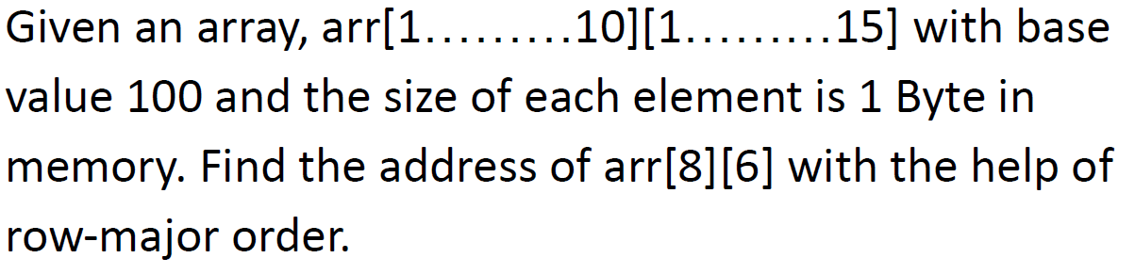
Calculate address of any element in 2D array Example 2
Source: https://www.geeksforgeeks.org/calculation-of-address-of-element-of-1-d-2-d-and-3-d-using-row-major-and-column-major-order/

Slide 20
Calculate address of any element in 2D array Example 2: Solution
Base address B = 100
Storage size of one element store in any array W = 1 Bytes
Row Subset of an element whose address to be found I = 8
Column Subset of an element whose address to be found J = 6
Lower Limit of row/start row index of matrix LR = 1
Lower Limit of column/start column index of matrix = 1
Number of column given in the matrix N = Upper Bound – Lower Bound + 1
= 15 – 1 + 1
= 15
Formula: Address of A[I][J] = B + W * ((I – LR) * N + (J – LC))
Solution: Address of A[8][6] = 100 + 1 * ((8 – 1) * 15 + (6 – 1))
= 100 + 1 * ((7) * 15 + (5))
= 100 + 1 * (110) = Address of A[I][J] = 210
Source: https://www.geeksforgeeks.org/calculation-of-address-of-element-of-1-d-2-d-and-3-d-using-row-major-and-column-major-order/

Slide 21
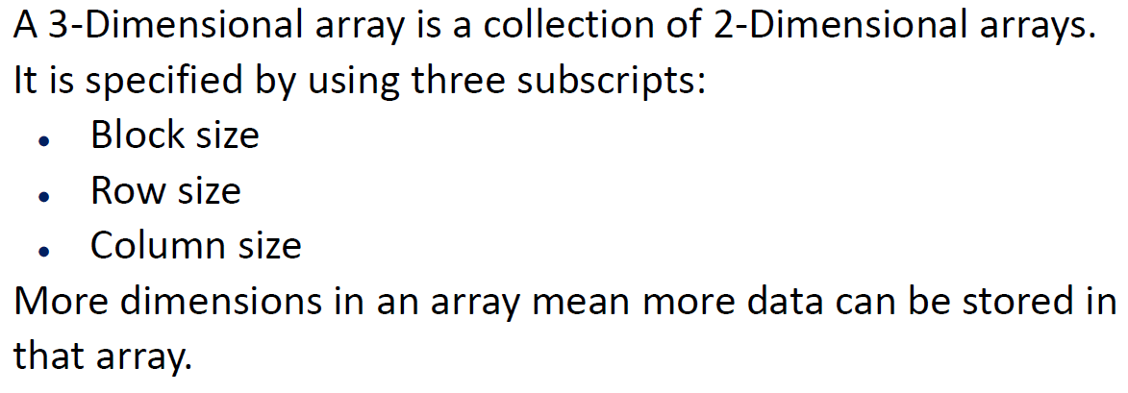
Multi-dimensional Arrays 3D-Arrays

Slide 22
Multi-dimensional Arrays 3D-Arrays
In 3-dimensional arrays, in general we will assume that the first index represents width of the array, the second index represents the row of the array and third index represents the column of the array.
(width_size, row_size, column_size
Source: https://www.geeksforgeeks.org/calculation-of-address-of-element-of-1-d-2-d-and-3-d-using-row-major-and-column-major-order/

Slide 23
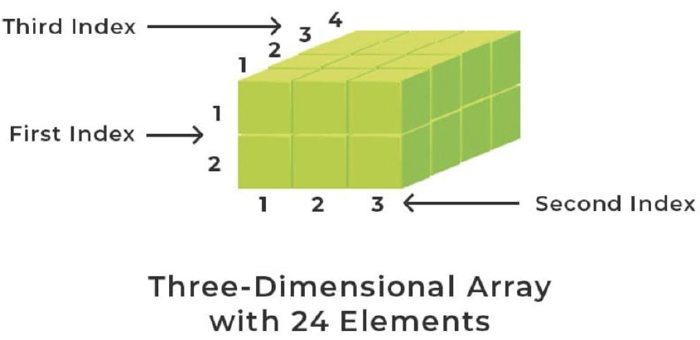
Multi-dimensional Arrays 3D-Arrays
Source: https://www.geeksforgeeks.org/calculation-of-address-of-element-of-1-d-2-d-and-3-d-using-row-major-and-column-major-order/

Slide 24
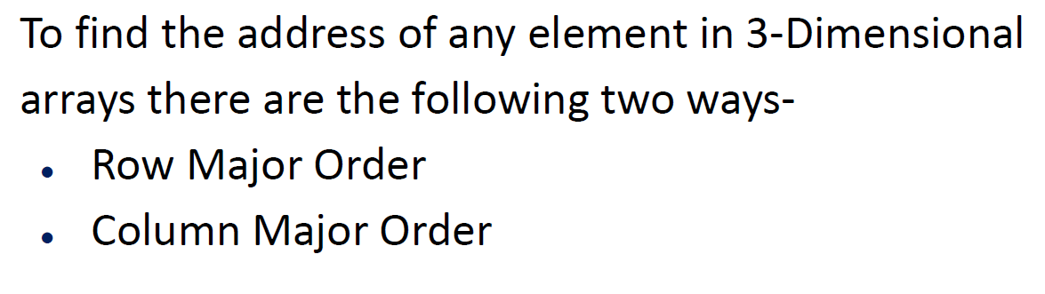
Multi-dimensional Arrays 3D-Arrays
Notes:
The concepts of row-major order and column-major order can be extended to 3D arrays and multidimensional arrays with more than two dimensions.
3D Arrays:
In a 3D array, elements are arranged along three dimensions (e.g., height, width, and depth). The order in which elements are stored in memory can follow row-major order or column-major order.
Row-Major Order (C-like Languages):
In row-major order, elements of each 2D slice (layer) are stored consecutively in memory. This means that the memory address increases primarily along rows and then along columns within each row.
Column-Major Order (Fortran-like Languages):
In column-major order, elements of each 2D slice are stored consecutively, but the memory address increases primarily along columns and then along rows within each column.
Multidimensional Arrays:
For arrays with more than three dimensions, the principles of row-major and column-major order continue to apply. Elements are stored consecutively in memory along one dimension at a time, with the order determined by whether it follows the row-major or column-major convention.
Impact on Access Patterns:
The choice of row-major or column-major order can affect the efficiency of accessing elements, especially in nested loops that iterate over the array. The order determines the pattern of memory access, which can impact cache locality and, consequently, the performance of algorithms.
Most programming languages, libraries, and systems use a particular memory layout as a default, and the developer needs to be aware of this when working with multidimensional arrays to optimize code for efficient memory access.
It's worth noting that, in practice, many programming languages, including C and C++, predominantly use row-major order for multidimensional arrays.

Slide 25
3D-Arrays Row Major Order
Address of A[i][j][k] = B + W *(M * N(i-x) + N *(j-y) + (k-z))
Here:
B = Base Address (start address)
W = Weight (storage size of one element stored in the array)
M = Row (total number of rows)
N = Column (total number of columns)
P = Width (total number of cells depth-wise)
x = Lower Bound of Row
y = Lower Bound of Column
z = Lower Bound of Width
Please read slide notes for additional info!
Notes:
The concepts of row-major order and column-major order can be extended to 3D arrays and multidimensional arrays with more than two dimensions.
3D Arrays:
In a 3D array, elements are arranged along three dimensions (e.g., height, width, and depth). The order in which elements are stored in memory can follow row-major order or column-major order.
Row-Major Order (C-like Languages):
In row-major order, elements of each 2D slice (layer) are stored consecutively in memory. This means that the memory address increases primarily along rows and then along columns within each row.
Column-Major Order (Fortran-like Languages):
In column-major order, elements of each 2D slice are stored consecutively, but the memory address increases primarily along columns and then along rows within each column.
Multidimensional Arrays:
For arrays with more than three dimensions, the principles of row-major and column-major order continue to apply. Elements are stored consecutively in memory along one dimension at a time, with the order determined by whether it follows the row-major or column-major convention.
Impact on Access Patterns:
The choice of row-major or column-major order can affect the efficiency of accessing elements, especially in nested loops that iterate over the array. The order determines the pattern of memory access, which can impact cache locality and, consequently, the performance of algorithms.
Most programming languages, libraries, and systems use a particular memory layout as a default, and the developer needs to be aware of this when working with multidimensional arrays to optimize code for efficient memory access.
It's worth noting that, in practice, many programming languages, including C and C++, predominantly use row-major order for multidimensional arrays.

Slide 26
Calculate address of any element in 3D array Example 3
Given an array, arr[1:9, -4:1, 5:10] with a base value of 400 and the size of each element is 2 Bytes in memory find the address of element arr[5][-1][8] with the help of row-major order?
Please read slide notes for info on lower bounds of arrays!
Source: https://www.geeksforgeeks.org/calculation-of-address-of-element-of-1-d-2-d-and-3-d-using-row-major-and-column-major-order/
Notes:
In many programming languages, including C++, the lower bounds of arrays are indeed assumed to be zero by default. In C++, arrays are 0-indexed by convention, meaning the first element has an index of 0. However, some languages and systems might support arbitrary lower bounds for arrays.
The inclusion of lower bounds in the formula is a generalization to account for cases where arrays may have non-zero lower bounds in one or more dimensions. This is a consideration for languages or systems that allow users to specify lower bounds other than zero. By including these lower bounds in the formula, it becomes more versatile and can handle a wider range of scenarios.
Here's why we include the lower bounds in the formula:
Generalization:
The formula is designed to be general and applicable to arrays with arbitrary lower bounds in each dimension. This makes the formula suitable for describing the memory layout of arrays in languages or systems that allow non-zero lower bounds.
Compatibility:
The formula works equally well for arrays with lower bounds of zero as it does for arrays with non-zero lower bounds. This ensures compatibility across different systems and languages.
Flexibility:
Including lower bounds makes the formula more flexible, allowing it to be adapted to specific requirements. Even though the default in languages like C++ is zero-based indexing, the formula can be applied to arrays with different lower bounds if needed.
In practical scenarios, especially in languages like C++, you might often encounter arrays with zero-based indexing, and in such cases, the lower bounds become effectively zero. However, the formula's inclusion of lower bounds ensures its applicability in a broader context.

Slide 27
Calculate address of any element in 3D array Example 3: Solution
Base address B = 400
Storage size of one element store in any array(in Byte) W = 2
Lower Limit of blocks in matrix x = 1
Lower Limit of row/start row index of matrix y = -4
Lower Limit of column/start column index of matrix z = 5
M(row) = Upper Bound – Lower Bound + 1 = 1 – (-4) + 1 = 6
N(Column)= Upper Bound – Lower Bound + 1 = 10 – 5 + 1 = 6
Formula used:
Address of[I][J][K] =B + W (M * N(i-x) + N *(j-y) + (k-z))
Solution:
Address of arr[5][-1][8] = 400 + 2 * {[6 * 6 * (5 – 1)] + 6 * [(-1 + 4)]} + [8 – 5]
= 400 + 2 * (6*6*4)+(6*3)+3
= 400 + 2 * (165) = 730
Source: https://www.geeksforgeeks.org/calculation-of-address-of-element-of-1-d-2-d-and-3-d-using-row-major-and-column-major-order/
Notes:
Block Subset of an element whose address to be found I = 5
Row Subset of an element whose address to be found J = -1
Column Subset of an element whose address to be found K = 8

Slide 28
3D-Arrays Column Major Order
Address of A[i][j][k]= B + W(M * N(i – x) + M *(k – z) + (j – y))
Here:
B = Base Address (start address)
W = Weight (storage size of one element stored in the array)
M = Row (total number of rows)
N = Column (total number of columns)
P = Width (total number of cells depth-wise)
x = Lower Bound of block (first subscipt)
y = Lower Bound of Row
z = Lower Bound of Column
Please read slide notes for additional info!
Notes:
The concepts of row-major order and column-major order can be extended to 3D arrays and multidimensional arrays with more than two dimensions.
3D Arrays:
In a 3D array, elements are arranged along three dimensions (e.g., height, width, and depth). The order in which elements are stored in memory can follow row-major order or column-major order.
Row-Major Order (C-like Languages):
In row-major order, elements of each 2D slice (layer) are stored consecutively in memory. This means that the memory address increases primarily along rows and then along columns within each row.
Column-Major Order (Fortran-like Languages):
In column-major order, elements of each 2D slice are stored consecutively, but the memory address increases primarily along columns and then along rows within each column.
Multidimensional Arrays:
For arrays with more than three dimensions, the principles of row-major and column-major order continue to apply. Elements are stored consecutively in memory along one dimension at a time, with the order determined by whether it follows the row-major or column-major convention.
Impact on Access Patterns:
The choice of row-major or column-major order can affect the efficiency of accessing elements, especially in nested loops that iterate over the array. The order determines the pattern of memory access, which can impact cache locality and, consequently, the performance of algorithms.
Most programming languages, libraries, and systems use a particular memory layout as a default, and the developer needs to be aware of this when working with multidimensional arrays to optimize code for efficient memory access.
It's worth noting that, in practice, many programming languages, including C and C++, predominantly use row-major order for multidimensional arrays.

Slide 29
Calculate address of any element in 3D array Example 4
Given an array arr[1:8, -5:5, -10:5] with a base value of 400 and the size of each element is 4 Bytes in memory find the address of element arr[3][3][3] with the help of column-major order?
Please read slide notes for info on lower bounds of arrays!
Source: https://www.geeksforgeeks.org/calculation-of-address-of-element-of-1-d-2-d-and-3-d-using-row-major-and-column-major-order/
Notes:
In many programming languages, including C++, the lower bounds of arrays are indeed assumed to be zero by default. In C++, arrays are 0-indexed by convention, meaning the first element has an index of 0. However, some languages and systems might support arbitrary lower bounds for arrays.
The inclusion of lower bounds in the formula is a generalization to account for cases where arrays may have non-zero lower bounds in one or more dimensions. This is a consideration for languages or systems that allow users to specify lower bounds other than zero. By including these lower bounds in the formula, it becomes more versatile and can handle a wider range of scenarios.
Here's why we include the lower bounds in the formula:
Generalization:
The formula is designed to be general and applicable to arrays with arbitrary lower bounds in each dimension. This makes the formula suitable for describing the memory layout of arrays in languages or systems that allow non-zero lower bounds.
Compatibility:
The formula works equally well for arrays with lower bounds of zero as it does for arrays with non-zero lower bounds. This ensures compatibility across different systems and languages.
Flexibility:
Including lower bounds makes the formula more flexible, allowing it to be adapted to specific requirements. Even though the default in languages like C++ is zero-based indexing, the formula can be applied to arrays with different lower bounds if needed.
In practical scenarios, especially in languages like C++, you might often encounter arrays with zero-based indexing, and in such cases, the lower bounds become effectively zero. However, the formula's inclusion of lower bounds ensures its applicability in a broader context.

Slide 30
Calculate address of any element in 3D array Example 4: Solution
Base address B = 400
Storage size of one element store in any array(in Byte) W = 4
Lower Limit of blocks in matrix x = 1
Lower Limit of row/start row index of matrix y = -5
Lower Limit of column/start column index of matrix z = -10
M (row)= Upper Bound – Lower Bound + 1 = 5 +5 + 1 = 11
N (column)= Upper Bound – Lower Bound + 1 = 5 + 10 + 1 = 16
Formula used:
Address of[i][j][k] = B + W(M * N(i – x) + M * (k-z) + (j-y))
Solution:
Address of arr[3][3][3] = 400 + 4 * ((11*16*(3-1)+11*(3-(-10)+(3-(-5)))
= 400 + 4 * ((176*2 + 11*13 + 8)
= 400 + 4 * (503)= 400 + 2012= 2412
Source: https://www.geeksforgeeks.org/calculation-of-address-of-element-of-1-d-2-d-and-3-d-using-row-major-and-column-major-order/
Notes:
Row Subset of an element whose address to be found I = 3
Column Subset of an element whose address to be found J = 3
Block Subset of an element whose address to be found K = 3

Slide 31
3D arrays Example 5
Assume you have a three-dimensional array laid out in column-major order with the first element at indices (1, 1, 1) (width, row, colum). What are the indices of the next element in memory?
1. (2,1,1)
2. (1,2,1)
3. (1,1,2)
4. None of above
Credits: Dr. Sidra Sultana

Slide 32
3D arrays Example 5: Solution
Assume you have a three-dimensional array laid out in column-major order with the first element at indices (1, 1, 1) (width, row, colum). What are the indices of the next element in memory?
1. (2,1,1)
2. (1,2,1) ←
3. (1,1,2)
4. None of above
Credits: Dr. Sidra Sultana

Slide 33
Time complexities of Arrays
Time complexity in computer science quantifies how the processing time of a code or algorithm relates to the input size, essentially measuring how long a program takes to process a given input.
It is defined as the number of times a particular instruction set is executed rather than the total time taken. It is because the total time taken also depends on some external factors like the compiler used, the processor’s speed, etc.

Slide 34
Time complexities of Arrays
Worst Time Complexities of Arrays
Data structure | Access | Search | Insertion | Deletion
Array | O(1) | O(N) | O(N) | O(N)
https://www.geeksforgeeks.org/time-complexities-of-different-data-structures/

Slide 35
DRY RUNNING OF 2D ARRAYS
#include <iostream>
int main() {
int a[2][2] = {{1,2},{3,4}};
int i,j;
for (i = 0; i<2 ; i++){
for (j = 0 ; j<2 ; j++)
{
std::cout <<a[i][j] << " ";
}
std::cout<< std::endl;
}
return 0;
}
Credits: Dr. Sidra Sultana

Slide 36
DRY RUNNING OF 2D ARRAYS
#include <iostream>
int main() {
int a[2][2] = {{1,2},{3,4}};
int i,j;
for (i = 0; i<2 ; i++){
for (j = 0 ; j<2 ; j++)
{
std::cout <<a[i][j] << " ";
}
std::cout<< std::endl;
}
return 0;
}
Output:
1 2
3 4
Credits: Dr. Sidra Sultana

Slide 37
Thank you

